Slide 1
AI AND MACHINE LEARNING
Hands-on introductory course

Slide 2
CLUSTERING

Slide 3
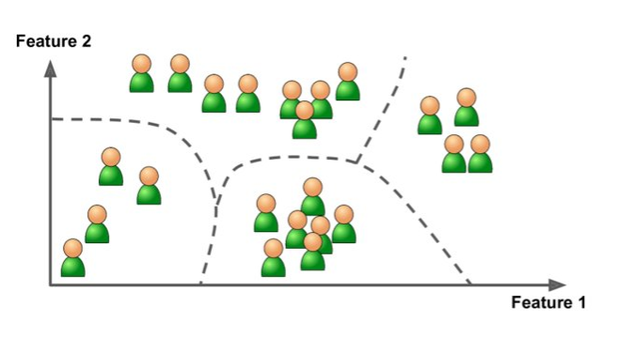
Unsupervised and supervised learning
Supervised learning
feed labelled training data (features + labels/value) to a model
using the model, predict the label/value of new data based on the features
everything in this course is supervised, except for clustering
Unsupervised learning
training data is not labelled
example: clustering (e.g. finding
similar products, ...)

Slide 4
Semisupervised learning
Erika
(labelled)
When you have both labelled and unlabelled data
Example
problem: given a set of images of people, Facebook wants to be able to recognize faces (‘tag’ people automatically)
Possible solution:
Find groups of similar faces in the images (clustering)
Users tag some images manually
As a result, the ‘clusters become labelled’
A new image can be labelled based on the cluster it is closest to
John
(labelled)
Notes:
not sure if facebook really does it this way
how are features “extracted” from images → see part about computer vision

Slide 5
Clustering algorithms
Nearest neighbour search
K-means
Agglomerative hierchical clustering
Density-based spatial clustering (DBSC)
Mean-Shift Clustering
Expectation-maximization (EM)
...
Notes:
“finding similar products”. In practise, recommender systems are built via techniques like collaborative filtering, this is out of scope...

Slide 6
A good clustering
data points in the same cluster have very similar features
data points of different clusters have very dissimilar features

Slide 7
Finding the centerpoints
Both K-means and mean-shift are based on finding the center points of the clusters
When the centerpoints of clusters are known, the clustering is finished
→ assign each data point to cluster with closest center point

Slide 8
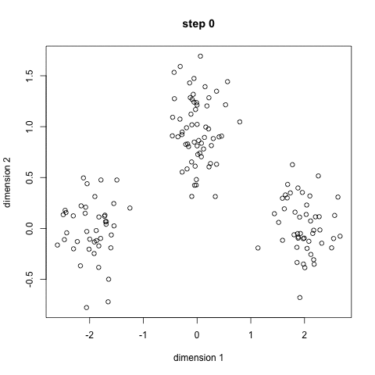
K-means
Initialize K random center points
Each datapoint is assigned to closest center point
Based on these groups, recalculate the center point
Repeat
Notes:
gif: from this blog
https://towardsdatascience.com/the-5-clustering-algorithms-data-scientists-need-to-know-a36d136ef68
gif address:
https://cdn-images-1.medium.com/max/1600/1*KrcZK0xYgTa4qFrVr0fO2w.gif

Slide 9
K-means
Disadvantages
must know number of clusters K in advance
results: different outcomes for different random intializations
Advantage: computationally fast (scales easily to large datasets)
Notes:
different random initializations → different outcomes
there are various theories about how to best initialize the center points
typically, do it with different initializations and pick the best outcome

Slide 10
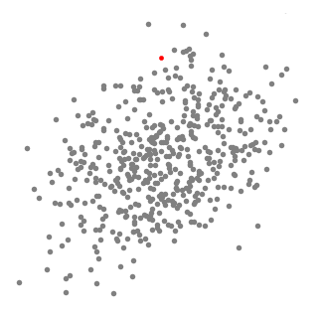
Mean-shift
Set a ‘seed’ at a random location
Set a fixed radius (hyperparameter)
Gradually shift the window to higher density region
Shift the center point to mean of points inside the window
As a result, at every iteration the density (amount of dots) within the window increases
Repeat untill amount of dots no longer increase
Notes:
By shifting to mean of points inside window, density increases naturally
of course, because when you shift to the midpoint of the points that are already inside the window, the new window will contain all points that were already in the window, plus possible more
gif from this blog
https://towardsdatascience.com/the-5-clustering-algorithms-data-scientists-need-to-know-a36d136ef68
gif address:
(1)
https://cdn-images-1.medium.com/max/1600/1*bkFlVrrm4HACGfUzeBnErw.gif

Slide 11
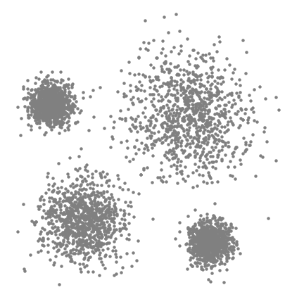
Mean-shift
Do this for many sliding windows (intialize many seeds)
In the end, remove overlapping windows (preserve the window with most points)
The centers of the windows are now the new cluster center points
How to initialize seeds
Affects both scalability and performance
Simplest: grid with spacing equal to kernel size
Notes:
How many seeds, and how to initialize them? affects scalability and performance, an “art”
One straightforward option is to intialize them in a grid with a grid spacing equal to the kernel size (“bandwidth” in sklearn, this is default option in the API)
gif from this blog
https://towardsdatascience.com/the-5-clustering-algorithms-data-scientists-need-to-know-a36d136ef68
(2)
https://cdn-images-1.medium.com/max/1600/1*vyz94J_76dsVToaa4VG1Zg.gif

Slide 12
Mean-shift
Disadvantages
Computationally expensive, especially in higher dimensions
Picking the radius (“kernel size”) is challenging
Advantage: finds number of clusters automatically
Notes:
complexity and computational expense: derivation out of scope
radius is a hyperparameter

Slide 13
More about clustering
This blogpost on Medium
https://towardsdatascience.com/the-5-clustering-algorithms-data-scientists-need-to-know-a36d136ef68
Documentation on Sklearn
Notes:
blogpost on medium perfectly fits the course (appropriate amount of detail but still high-level, nice illustrations)
documentation in sklearn also always provides a lot of info about the different algorithms
advantage is that explanation is directly done with name of parameters matching the ones in the API

Slide 14
Other algorithms
Out of scope
Address typical disadvantages of both K-means and mean-shift
Choice of algorithm depends on shape and nature of the data
K-means and mean-shift: best for clusters that seem circular

Slide 15
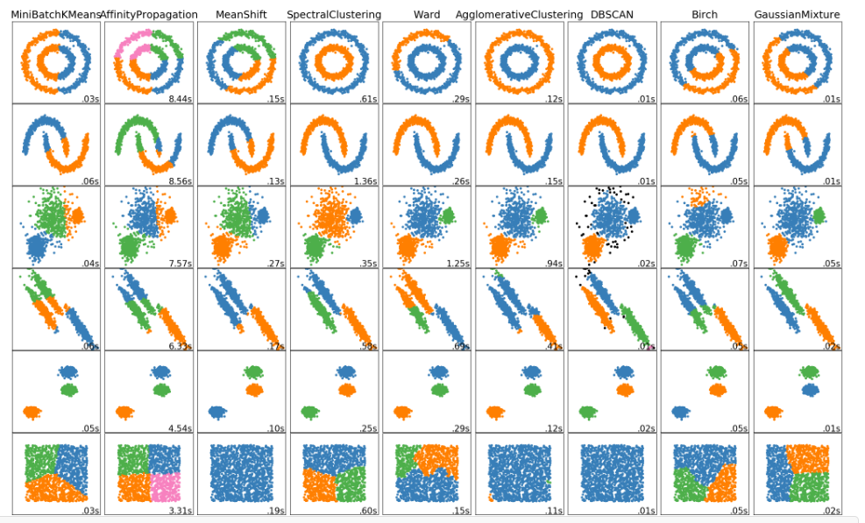
Notes:
From Sklearn documentation

Slide 16
Clustering of text
Exercise: clustering of text
But first, we must talk about how to represent text...
Notes:
e.g. group news articles into categories on a website. Direct user to list of similar articles

Slide 17
Representing text
All our machine learning models are based on features of data points
How do we represent text as features (“feature engineering”)

Slide 18
Representing text: bag of words
From a large dataset of texts, build a vocabulary of all unique words
Add an extra “unknown” value for unknown words
Bag of words
Count number of times each word of the vocabulary appears in the text
Ignore the order of words!

Slide 19
VOCUBULARY
Index | Word
0 | An
1 | Illustration
2 | cat
3 | dog
4 | woman
5 | representation
6 | the
7 | bag
8 | this
9 | stop
10 | is
11 | words
... | ...
100 000 | of
“this is an illustration of the bag of words representation”
1 | 1 | 0 | 0 | 0 | 1 | 1 | 1 | 1 | 0 | 1 | 1 | ... | 2
Vocabulary of N different words
represent each text as a (sparse) vector of N features
Notes:
sparse means a lot of zeros
recurrent neural networks don’t ignore the order of words!
in recurrent neural networks, text is also represented in a more advanced way. It feeds each word seperately and each word is represented as a special embedding vector. See later
You could also preprocess plural/singular or verb tenses
e.g. “word” and “words” are counted together
“play” and “plays” are counted together

Slide 20
Bag of words
“this is an illustration of the bag of words representation”
1 | 1 | 0 | 0 | 0 | 1 | 1 | 1 | 1 | 0 | 1 | 1 | ... | 2
With this vector of N features, you could start the clustering algorithm
# “an”
# “this”
Notes:
“distance” is measured by euclidian distance in multidimensional space
other measure of similary would be inner product of vectors

Slide 21
Normalization
Without normalization, the results are affected by the lenght of the piece of text
Two articles about Sports will not be similar, if one article is short an the other is long
Solution: normalization
SUM = 10
( = total amount of words )
1 | 1 | 0 | 0 | 0 | 1 | 1 | 1 | 1 | 0 | 1 | 1 | ... | 2
Divide by SUM (=10)
0,1 | 0,1 | 0 | 0 | 0 | 0,1 | 0,1 | 0,1 | 0,1 | 0 | 0,1 | 0,1 | ... | 0,2

Slide 22
TF-IDF: rare versus common words
Say you have texts (documents) about ‘travelling’ and ‘cooking’
These are two clusters of similar texts
Similar texts have a similar ‘rare’ vocabulary
Cooking: “pot”, “butter”, “bread”, “flour”
Travelling: “plane”, “destination”, “going”, “luggage”, “Benidorm”
These words are important, they are rarely used in the other category
Both categories have a lot common words
“the”, “I”, “a”, “we”, “it”, “are”, ....
These words are common in all categories
They should be unimportant
Really, they are just noise in the data
In the current bag-of-words model, they are equally import as the rare words

Slide 23
TF-IDF representation
Term-Frequency – Inverse Document Frequency

